Slide 1

Floating Point
CSCI3240: Lecture 4 and 5
Dr. Arpan Man Sainju
Middle Tennessee State University

Slide 2
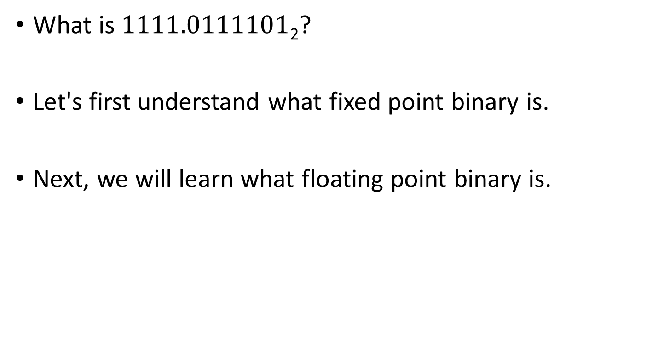
Representing Real Numbers in Binary
Carnegie Mellon
What is $1111.0111101$₂?
Let's first understand what fixed point binary is.
Next, we will learn what floating point binary is.

Slide 3
Fixed Point Binary Fractions
Whole number portion of real number
0 | 0 | 0 | 0 | 0 | 1 | 1 | 1 | 1 | 0 | 1 | 1 | 1 | 1 | 0 | 1
Represents fractional part
of the real number
0 | 0 | 0 | 0 | 0 | 1 | 1 | 1 | 1 | 0 | 1 | 1 | 1 | 1 | 0 | 1
We can use an imaginary binary point to separate whole number from fractional part.
The position of the binary point is fixed and can’t be moved.
In this example, 9-bits are used to represent whole number portion and 7 bits are used to represent fractional part.

Slide 4
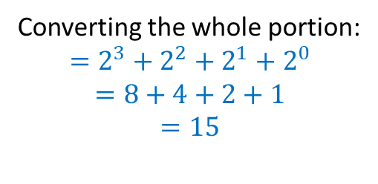
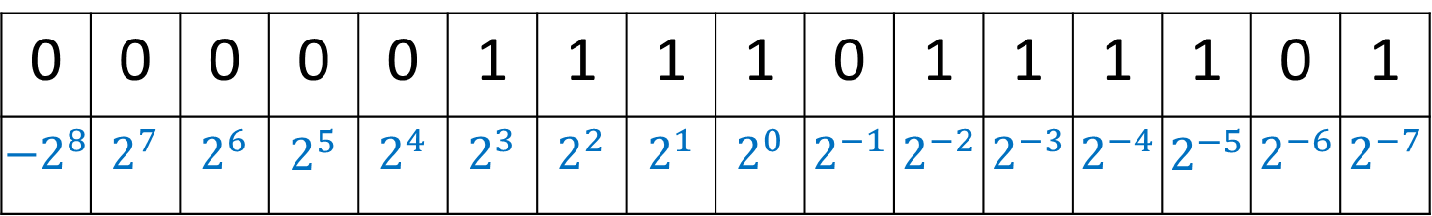
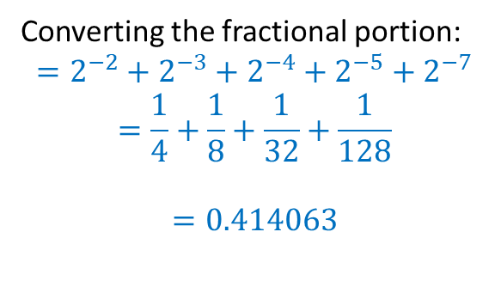
Converting Fixed Point Binary to Denary
0 | 0 | 0 | 0 | 0 | 1 | 1 | 1 | 1 | 0 | 1 | 1 | 1 | 1 | 0 | 1
${−2}^{8}$ | $2^{7}$ | $2^{6}$ | $2^{5}$ | $2^{4}$ | $2^{3}$ | $2^{2}$ | $2^{1}$ | $2^{0}$ | $2^{−1}$ | $2^{−2}$ | $2^{−3}$ | $2^{−4}$ | $2^{−5}$ | $2^{−6}$ | $2^{−7}$
Converting the whole portion:
$$=2^{3}+2^{2}+2^{1}+2^{0}$$
$$=8+4+2+1$$
$$=15$$
Converting the fractional portion:
$$=2^{−2}+2^{−3}+2^{−4}+2^{−5}+2^{−7}$$
$$=\frac{1}{4}+\frac{1}{8}+\frac{1}{32}+\frac{1}{128}$$
$$=0.414063$$
$${\left(000001111.0111101\right)}_{2}= 15+0.414063= 15.414063$$

Slide 5
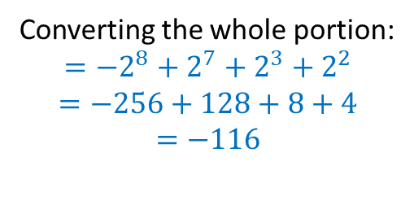
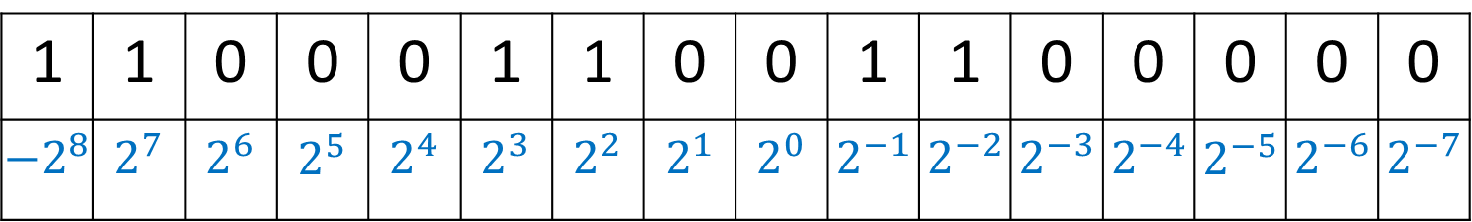
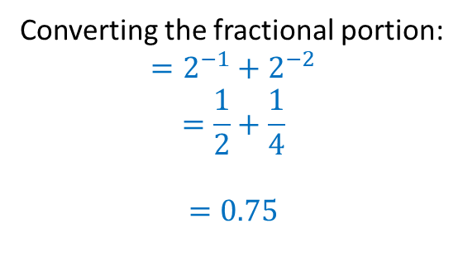
Another Example
1 | 1 | 0 | 0 | 0 | 1 | 1 | 0 | 0 | 1 | 1 | 0 | 0 | 0 | 0 | 0
${−2}^{8}$ | $2^{7}$ | $2^{6}$ | $2^{5}$ | $2^{4}$ | $2^{3}$ | $2^{2}$ | $2^{1}$ | $2^{0}$ | $2^{−1}$ | $2^{−2}$ | $2^{−3}$ | $2^{−4}$ | $2^{−5}$ | $2^{−6}$ | $2^{−7}$
Converting the whole portion:
$$={−2}^{8}+2^{7}+2^{3}+2^{2}$$
$$=−256+128+8+4$$
$$=−116$$
Converting the fractional portion:
$$=2^{−1}+2^{−2}$$
$$=\frac{1}{2}+\frac{1}{4}$$
$$=0.75$$
$${\left(110001100.1100000\right)}_{2}= −116+.75= −115.25$$

Slide 6
Practice Questions
The following binary numbers are stored using two’s complement in a 12-bit register with 4 bits after the binary point. Convert them into decimal fraction.
010001111010
111111111111
100001110010

Slide 7
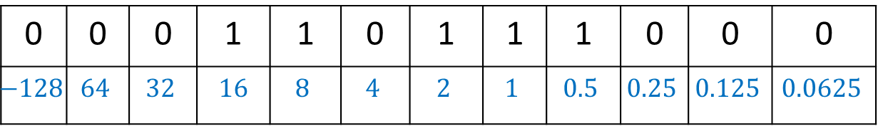
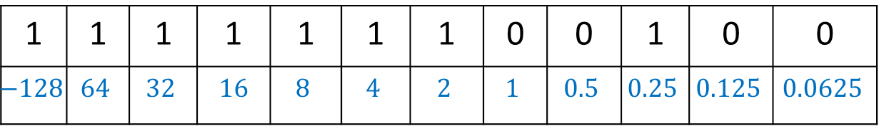
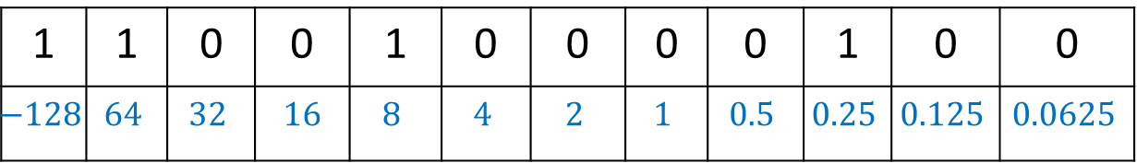
Practice Questions
Using two’s complement, convert the following decimal numbers into fixed point binary to be stored in a 12 bit register with 4-bit after the binary point.
27.5
-55.75
-1.75
0 | 0 | 0 | 1 | 1 | 0 | 1 | 1 | 1 | 0 | 0 | 0
$$−128$$ | $$64$$ | $$32$$ | $16$ | $$8$$ | $$4$$ | $$2$$ | $$1$$ | $$0.5$$ | $$0.25$$ | $$0.125$$ | $$0.0625$$
1 | 1 | 0 | 0 | 1 | 0 | 0 | 0 | 0 | 1 | 0 | 0
$$−128$$ | $$64$$ | $$32$$ | $16$ | $$8$$ | $$4$$ | $$2$$ | $$1$$ | $$0.5$$ | $$0.25$$ | $$0.125$$ | $$0.0625$$
1 | 1 | 1 | 1 | 1 | 1 | 1 | 0 | 0 | 1 | 0 | 0
$$−128$$ | $$64$$ | $$32$$ | $16$ | $$8$$ | $$4$$ | $$2$$ | $$1$$ | $$0.5$$ | $$0.25$$ | $$0.125$$ | $$0.0625$$

Slide 8

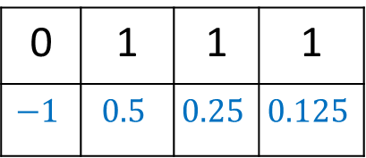

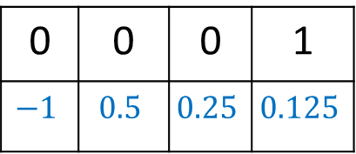
Observation
Given a 4-bit register, with 1-bit before and 3-bit after the binary point, using two’s complement, calculate:
The largest positive number that can be represented is
The smallest positive number that can be represented (not including 0)
0 | 1 | 1 | 1
$$−1$$ | $$0.5$$ | $$0.25$$ | $$0.125$$
$=0.5+0.25+0.125=0.875$
0 | 0 | 0 | 1
$$−1$$ | $$0.5$$ | $$0.25$$ | $$0.125$$
$$=0.125$$

Slide 9
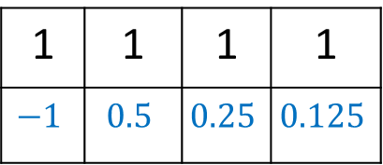

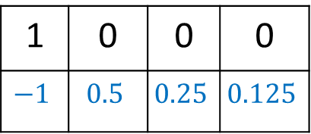
Observation
Given a 4-bit register, with 1-bit before and 3-bit after the binary point, using two’s complement, calculate:
The smallest magnitude negative number that can be represented (closet to 0)
The largest magnitude negative number that can be represented
1 | 1 | 1 | 1
$$−1$$ | $$0.5$$ | $$0.25$$ | $$0.125$$
$=−1+0.5+0.25+0.125=−0.125$
1 | 0 | 0 | 0
$$−1$$ | $$0.5$$ | $$0.25$$ | $$0.125$$
$$=−1$$

Slide 10
Summary
Fixed point binary is used in digital signal processing.
It is employed when performance is more important than accuracy.
Gaming
Simple and cheaper processor hardware
Faster processing
Tradeoff between range and precision
Some numbers can never be represented accurately. Such as 1/10.

Slide 11

Floating Point Binary
Standard Scientific Notation
$2.99 x {10}^{8}$ Speed of light
$6.02 x {10}^{23}$ Avogadro’s number
$1.60 x {10}^{−19}$ Charge of electron

Slide 12


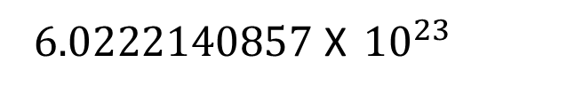
Floating Point
Number written in scientific notation have three components:
$−1.25$ X ${10}^{−5}$
sign
Mantissa
Exponent
$$= − 0.0000125$$
$6.0222140857$ X ${10}^{23}$
Sign
(by default, positive)
Mantissa
Exponent
$$=602221408570000000000000$$
The number of digits that you are allowed to use in Mantissa governs the precision of values.
The number of digits available for exponent governs the range. For 2 digits you can only float the point up to 99 places.

Slide 13
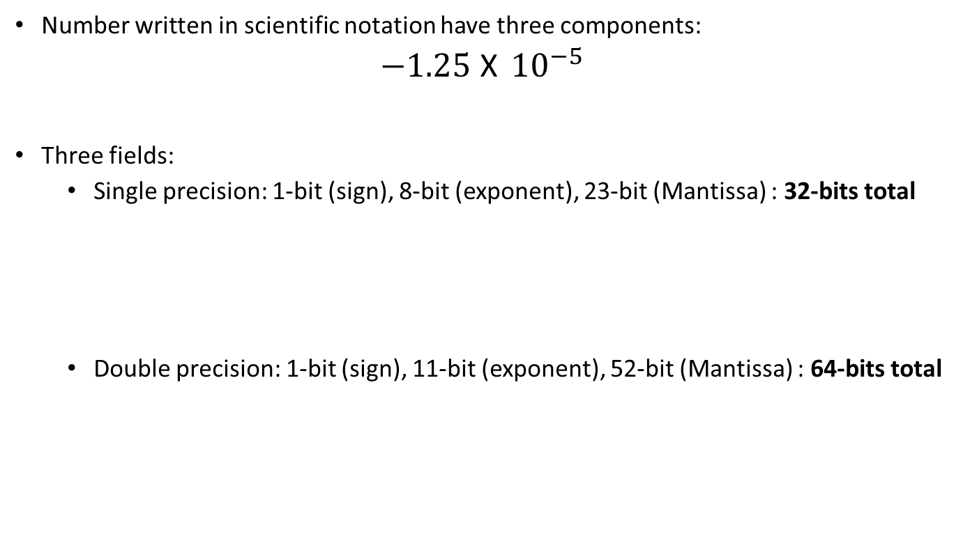
IEEE 754 Standard for Floating-Point Representation
Number written in scientific notation have three components:
$−1.25$ X ${10}^{−5}$
Three fields:
Single precision: 1-bit (sign), 8-bit (exponent), 23-bit (Mantissa) : 32-bits total
Double precision: 1-bit (sign), 11-bit (exponent), 52-bit (Mantissa) : 64-bits total
sign
Mantissa
Exponent
Sign
Exponent
Mantissa
1 Bit
8 Bit
23 Bit
Sign
Exponent
Mantissa
1 Bit
11 Bit
52 Bit
Mantissa: fraction part of a floating-point number

Slide 14
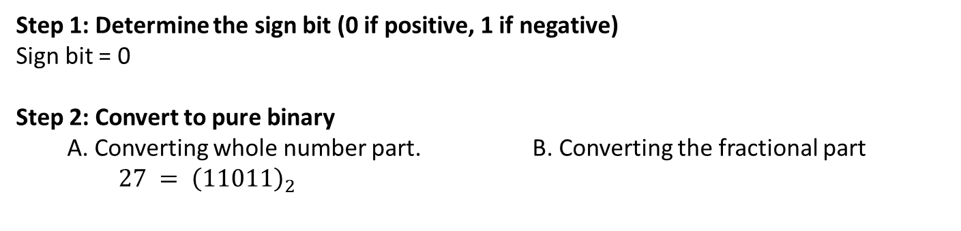

IEEE 754 Standard for Single Precision 32-bit floating point binary
Sign bit
Exponent
Mantissa
0
1-bit
8-bit
23-bit
Convert the real number 27.236875 into IEEE 7544 standard 32-bit floating point binary
Step 1: Determine the sign bit (0 if positive, 1 if negative)
Sign bit = 0
Step 2: Convert to pure binary
A. Converting whole number part. B. Converting the fractional part
$27 = {\left(11011\right)}_{2}$
$$0.236875 × 2 =0.47375 0$$
$$0.47375×2 = 0.875 0$$
$$0.875 ×2 =1.75 1$$
$$27.2185={\left(11011.00111\right)}_{2}$$
$$0.75 × 2 =1.50 1$$
$$0.50 × 2 =1.00 1$$
Stop when product is 1

Slide 15
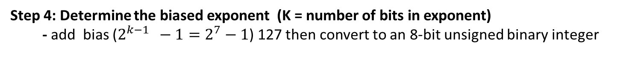
IEEE 754 Standard for Single Precision 32-bit floating point binary
Sign bit
Exponent
Mantissa
0 | 1 | 0 | 0 | 0 | 0 | 0 | 1 | 1
1 | 0 | 1 | 1 | 0 | 0 | 1 | 1 | 1 | 0 | 0 | 0 | 0 | 0 | 0 | 0 | 0 | 0 | 0 | 0 | 0 | 0 | 0
0
1-bit
8-bit
23-bit
Convert the real number 27.2185 into IEEE 754 standard 32-bit floating point binary
Step 3: Normalize to determine the Mantissa and the unbiased exponent
- place the binary point after leftmost 1
$$11011.00111=1.101100111 x 2^{4}$$
$$Unbiased Exponent =4=000000100$$
Step 4: Determine the biased exponent (K = number of bits in exponent)
- add bias ($2^{k−1 } −1=2^{7}−1$) 127 then convert to an 8-bit unsigned binary integer
$$=4+127=131={\left(10000011\right)}_{2}$$
Note:
the left most bit of Mantissa is always going to be 1. (see step 3)
No need to store it.
We get extra 1-bit precision
Step 5: Remove the leading 1 from the Mantissa
- remove the leftmost 1
$$Mantissa =101100111$$

Slide 16
Why do we need to add bias to the exponent?

Slide 17
Assume 4-bit
exponent
Only +ve
exponents
Two’s
complement
Changing range
IEEE 754 Standard
0 | 0 | 0 | 0
0 | 0 | 0 | 1
0 | 0 | 1 | 0
0 | 0 | 1 | 1
0 | 1 | 0 | 0
0 | 1 | 0 | 1
0 | 1 | 1 | 0
0 | 1 | 1 | 1
1 | 0 | 0 | 0
1 | 0 | 0 | 1
1 | 0 | 1 | 0
1 | 0 | 1 | 1
1 | 1 | 0 | 0
1 | 1 | 0 | 1
1 | 1 | 1 | 0
1 | 1 | 1 | 1
0
1
2
3
4
5
6
7
8
9
10
11
12
13
14
15
0
1
2
3
4
5
6
7
-8
-7
-6
-5
-4
-3
-2
-1
-5
-4
-3
-2
-1
0
1
2
3
4
5
6
7
8
9
10
-9
-8
-7
-6
-5
-4
-3
-2
-1
0
1
2
3
4
5
6
-7
-6
-5
-4
-3
-2
-1
0
1
2
3
4
5
6
7
8
Slightly favors positive numbers
Here, bias is 7 because we have 7 -ve numbers.
We have to add bias to convert the number into unsinged binary for IEEE 754 standard.
-7 +7 = 0
-6 +7 = 1
-5+7 = 2
6 + 7 = 13

Slide 18
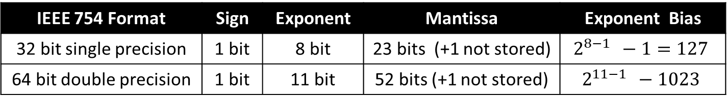
Exponent bias
IEEE 754 Format | Sign | Exponent | Mantissa | Exponent Bias
32 bit single precision | 1 bit | 8 bit | 23 bits (+1 not stored) | $$2^{8−1 } −1=127$$
64 bit double precision | 1 bit | 11 bit | 52 bits (+1 not stored) | $$2^{11−1 } −1023$$

Slide 19
Why not use Two’s complement instead of IEEE 754 Standard for exponent?
Two’s complement
IEEE 754 Standard
0 | 0 | 0 | 0
0 | 0 | 0 | 1
0 | 0 | 1 | 0
0 | 0 | 1 | 1
0 | 1 | 0 | 0
0 | 1 | 0 | 1
0 | 1 | 1 | 0
0 | 1 | 1 | 1
1 | 0 | 0 | 0
1 | 0 | 0 | 1
1 | 0 | 1 | 0
1 | 0 | 1 | 1
1 | 1 | 0 | 0
1 | 1 | 0 | 1
1 | 1 | 1 | 0
1 | 1 | 1 | 1
0
1
2
3
4
5
6
7
-8
-7
-6
-5
-4
-3
-2
-1
-7
-6
-5
-4
-3
-2
-1
0
1
2
3
4
5
6
7
8
With IEEE 754 standard the computer can easily identify if one number is bigger then another by just looking at the bit pattern.
It is not possible with 2’s complement.
See 7 and -8.

Slide 20
Practice Questions
Convert 0.6875 into IEEE 754 single precision floating point binary
Step 1: Determine the sign
Step 2: Convert to pure binary
Step 3: Normalize for Mantissa and unbiased exponent
Step 4: Determine biased exponent
Step 5: Remove leading 1 from Mantissa

Slide 21
Practice Question
Convert -123.84375 into IEEE 754 single precision floating point binary
Step 1: Determine the sign
Step 2: Convert to pure binary
Step 3: Normalize for Mantissa and unbiased exponent
Step4: Determine biased exponent
Step5: Remove leading 1 from Mantissa

Slide 22
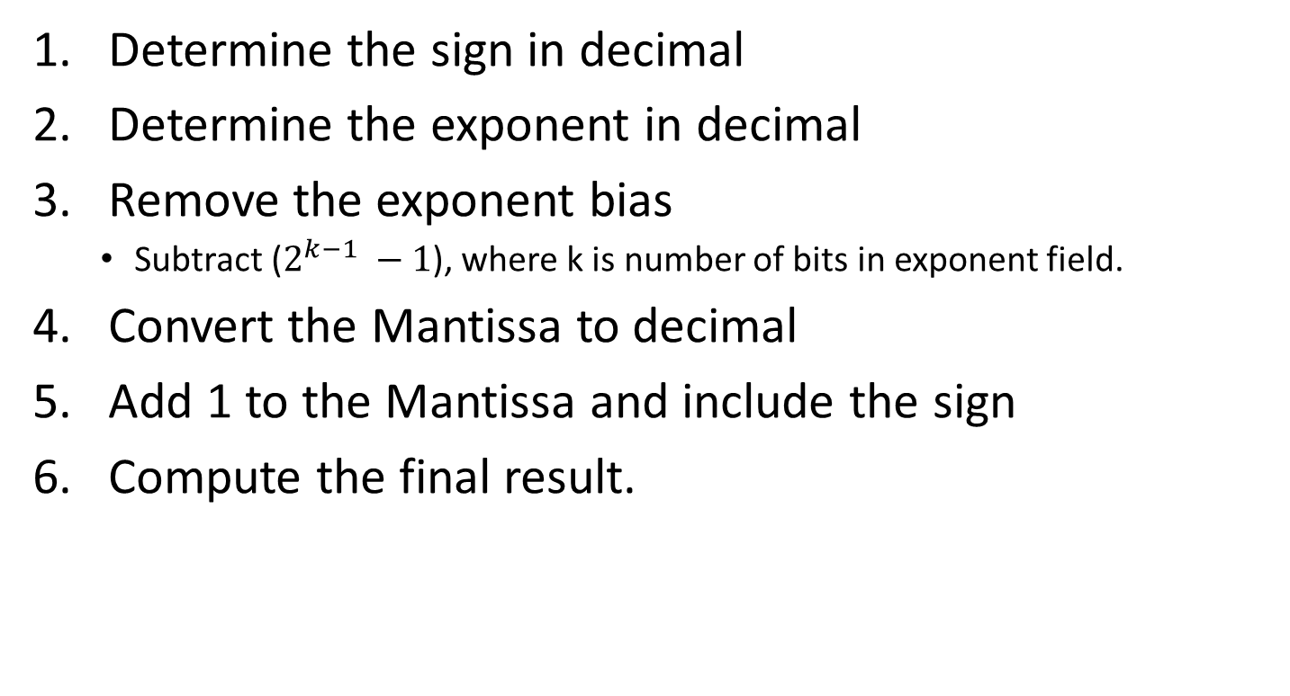
Converting back to decimal
Determine the sign in decimal
Determine the exponent in decimal
Remove the exponent bias
Subtract ($2^{k−1} −1$), where k is number of bits in exponent field.
Convert the Mantissa to decimal
Add 1 to the Mantissa and include the sign
Compute the final result.

Slide 23
Practice Question
Convert 01000001001101010000000000000000 into decimal

Slide 24
Practice Question
Convert 10000001001000110010000000000000 into decimal

Slide 25
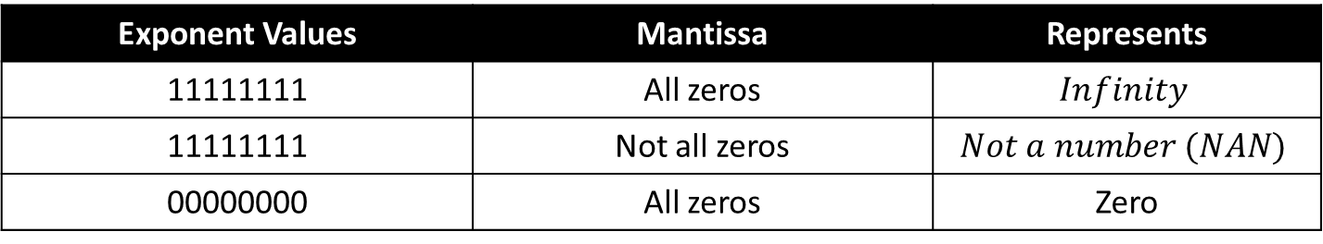
Reserved Exponent Values
Exponent Values | Mantissa | Represents
11111111 | All zeros | $$Infinity$$
11111111 | Not all zeros | $$Not a number (NAN)$$
00000000 | All zeros | Zero

Slide 26
Floating Point Operations: Basic Idea
Carnegie Mellon
x +f y = Round(x + y)
x ×f y = Round(x × y)
Basic idea
First compute exact result
Make it fit into desired precision
Possibly overflow if exponent too large
Possibly round to fit into Mantissa fraction

Slide 27
Rounding
Carnegie Mellon
Rounding Modes (illustrate with $ rounding)
$1.40 $1.60 $1.50 $2.50 –$1.50
Towards zero $1 $1 $1 $2 –$1
Round down (−∞) $1 $1 $1 $2 –$2
Round up (+∞) $2 $2 $2 $3 –$1
Nearest Even (default) $1 $2 $2 $2 –$2

Slide 28
Rounding Binary Numbers
Carnegie Mellon
Binary Fractional Numbers
“Even” when least significant bit is 0
“Half way” when bits to right of rounding position = 100…2
Examples
Round to nearest 1/4 (2 bits right of binary point)
Value Binary Rounded Action Rounded Value
2 3/32 10.000112 10.002 (<1/2—down) 2
2 3/16 10.001102 10.012 (>1/2—up) 2 1/4
2 7/8 10.111002 11.002 ( 1/2—up) 3
2 5/8 10.101002 10.102 ( 1/2—down) 2 1/2

Slide 29
FP Multiplication
Carnegie Mellon
(–1)^{s1} M1 2^{E1} x (–1)^{s2} M2 2^{E2}
Exact Result: (–1)^{s} M 2E
Sign s: s1 ^ s2
Mantissa M: M1 x M2
Exponent E: E1 + E2
Fixing
Normalize (move decimal point after first 1)
If E out of range, overflow
Round M to fit Mantissa fraction precision
Implementation
Biggest chore is multiplying Mantissas

Slide 30
Floating Point Addition
Carnegie Mellon
(–1)^{s1} M1 2^{E1} + (-1)^{s2} M2 2^{E2}
Assume E1 > E2
Exact Result: (–1)^{s} M 2E
Sign s, Mantissa M:
Result of signed align & add
Exponent E: E1
Fixing
Normalize (move decimal point after first 1)
Overflow if E out of range
Round M to fit Mantissa fraction precision
Get binary points lined up
E1–E2
(–1)^{s1} M1
+
(–1)^{s2} M2
(–1)^{s} M

Slide 31
Mathematical Properties of FP Add
Carnegie Mellon
Compare to those of Abelian Group
Closed under addition?
But may generate infinity or NaN
Commutative?
Associative?
Overflow and inexactness of rounding
(3.14+1e10)-1e10 = 0, 3.14+(1e10-1e10) = 3.14
0 is additive identity?
Every element has additive inverse?
Yes, except for infinities & NaNs
Monotonicity
a ≥ b ⇒ a+c ≥ b+c?
Except for infinities & NaNs
Yes
Yes
No
Yes
Almost
Almost

Slide 32
Mathematical Properties of FP Mult
Carnegie Mellon
Compare to Commutative Ring
Closed under multiplication?
But may generate infinity or NaN
Multiplication Commutative?
Multiplication is Associative?
Possibility of overflow, inexactness of rounding
Ex: (1e20*1e20)*1e-20= inf, 1e20*(1e20*1e-20)= 1e20
1 is multiplicative identity?
Multiplication distributes over addition?
Possibility of overflow, inexactness of rounding
1e20*(1e20-1e20)= 0.0, 1e20*1e20 – 1e20*1e20 = NaN
Monotonicity
a ≥ b & c ≥ 0 ⇒ a * c ≥ b *c?
Except for infinities & NaNs
Yes
Yes
No
Yes
No
Almost

Slide 33
Floating Point in C
Carnegie Mellon
C Guarantees Two Levels
float single precision
double double precision
Conversions/Casting
Casting between int, float, and double changes bit representation
double/float → int
Truncates fractional part
Like rounding toward zero
Not defined when out of range or NaN: Generally sets to TMin
int → double
Exact conversion, as long as int has ≤ 53 bit word size
int → float
Will round according to rounding mode

Slide 34
Floating Point Puzzles
Carnegie Mellon
For each of the following C expressions, either:
Argue that it is true for all argument values
Explain why not true
x == (int)(float) x
x == (int)(double) x
f == (float)(double) f
d == (double)(float) d
f == -(-f);
2/3 == 2/3.0
d < 0.0 ⇒ ((d*2) < 0.0)
d > f ⇒ -f > -d
d * d >= 0.0
(d+f)-d == f
int x = …;
float f = …;
double d = …;
Assume neither
d nor f is NaN

